Slide 1
MUTATION TESTING

Slide 2
MUTATION TESTING
MUTATION TESTING IS A TYPE OF SOFTWARE TESTING WHERE WE MUTATE (CHANGE) CERTAIN STATEMENTS IN THE SOURCE CODE AND CHECK IF THE TEST CASES ARE ABLE TO FIND THE ERRORS.
THE CHANGES IN MUTANT PROGRAM ARE KEPT EXTREMELY SMALL, SO IT DOES NOT AFFECT THE OVERALL OBJECTIVE OF THE PROGRAM.

Slide 3
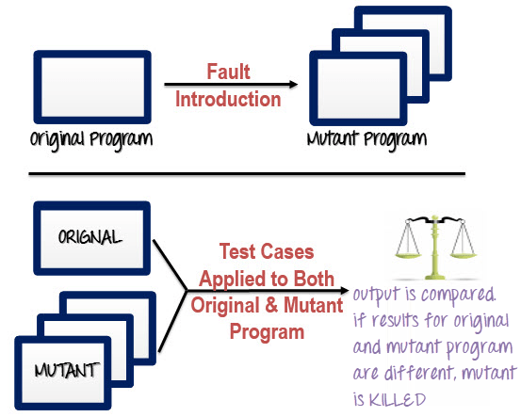

Slide 4
STEPS TO EXECUTE MUTATION TESTING
STEP 1:
FAULTS ARE INTRODUCED INTO THE SOURCE CODE OF THE PROGRAM BY CREATING MANY VERSIONS CALLED MUTANTS.
EACH MUTANT SHOULD CONTAIN A SINGLE FAULT.
THE GOAL IS TO CAUSE THE MUTANT VERSION TO FAIL WHICH DEMONSTRATES THE EFFECTIVENESS OF THE TEST CASES.

Slide 5
STEPS TO EXECUTE MUTATION TESTING
STEP 2:
TEST CASES ARE APPLIED TO THE ORIGINAL PROGRAM AND ALSO TO THE MUTANT PROGRAM.
A TEST CASE SHOULD BE ADEQUATE, AND IT IS TWEAKED TO DETECT FAULTS IN A PROGRAM.
STEP 3:
COMPARE THE RESULTS OF ORIGINAL AND MUTANT PROGRAM.

Slide 6
STEPS TO EXECUTE MUTATION TESTING
STEP 4:
IF THE ORIGINAL PROGRAM AND MUTANT PROGRAMS GENERATE THE DIFFERENT OUTPUT, THEN THAT THE MUTANT IS KILLED BY THE TEST CASE.
HENCE THE TEST CASE IS GOOD ENOUGH TO DETECT THE CHANGE BETWEEN THE ORIGINAL AND THE MUTANT PROGRAM.

Slide 7
STEPS TO EXECUTE MUTATION TESTING
STEP 5:
IF THE ORIGINAL PROGRAM AND MUTANT PROGRAM GENERATE SAME OUTPUT, MUTANT IS KEPT ALIVE.
IN SUCH CASES, MORE EFFECTIVE TEST CASES NEED TO BE CREATED THAT KILL ALL MUTANTS.

Slide 8
Mutant Programs
A MUTATION IS A SINGLE SYNTACTIC CHANGE THAT IS MADE TO THE PROGRAM STATEMENT.
EACH MUTANT PROGRAM SHOULD DIFFER FROM THE ORIGINAL PROGRAM BY ONE MUTATION.
Original Program If (x>y) Print "Hello" Else Print "Hi" | Mutant Program If(x<y) Print "Hello" Else Print "Hi"

Slide 9
SOME OF SAMPLE MUTATION OPERATORS
GOTO LABEL REPLACEMENT
RETURN STATEMENT REPLACEMENT
STATEMENT DELETION
UNARY OPERATOR INSERTION (LIKE – AND ++)
LOGICAL CONNECTOR REPLACEMENT
COMPARABLE ARRAY
NAME REPLACEMENT
REMOVING OF ELSE PART IN THE IF-ELSE STATEMENT
ADDING OR REPLACEMENT OF OPERATORS
STATEMENT REPLACEMENT BY CHANGING THE DATA
DATA MODIFICATION FOR THE VARIABLES
MODIFICATION OF DATA TYPES IN THE PROGRAM

Slide 10
TYPES OF MUTATION TESTING
STATEMENT MUTATION:
DEVELOPER CUT AND PASTES A PART OF CODE OF WHICH THE OUTCOME MAY BE REMOVAL OF SOME LINES.
VALUE MUTATION:
VALUES OF PRIMARY PARAMETERS ARE MODIFIED.
DECISION MUTATION:
CONTROL STATEMENTS ARE TO BE CHANGED.

Slide 11
MUTATION SCORE
THE MUTATION SCORE IS DEFINED AS THE PERCENTAGE OF KILLED MUTANTS WITH THE TOTAL NUMBER OF MUTANTS.
MUTATION SCORE = (KILLED MUTANTS / TOTAL NUMBER OF MUTANTS) * 100

Slide 12
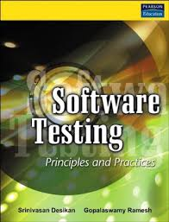



REFERENCES

